Slide 1
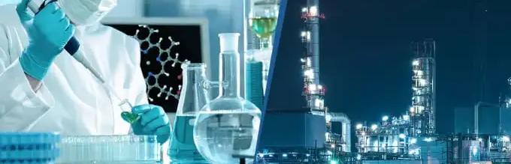
Industrial Chemistry
Ethanol production

Slide 2

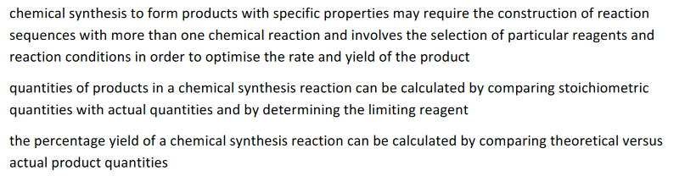

Overview

Slide 3
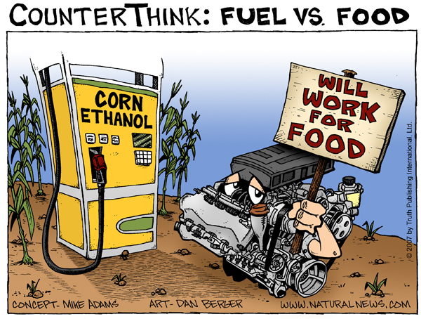
Biofuels
Bioethanol and biodiesel are produced from biomass and are alternatives from fossil fuels
Biofuels are a renewable resource
Essentially natural products with little consequences to exposure
Carbon dioxide emissions are considered neutral
Little sulfur content
Burn cleaner

Slide 4
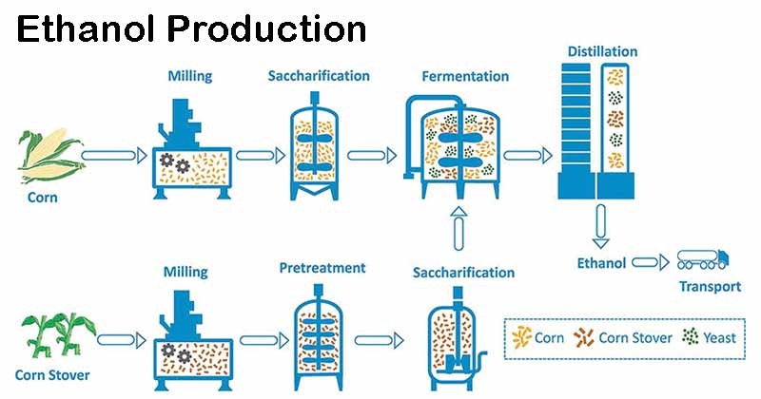

Ethanol from fermentation
93% of world ethanol production relies on yeast to produce enzymes capable of catalysing the conversion of plant carbohydrates
Corn, wheat, sugar cane, potatoes
Relies on Yeast (living) that produces enzymes

Slide 5
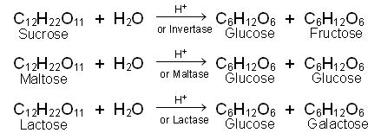

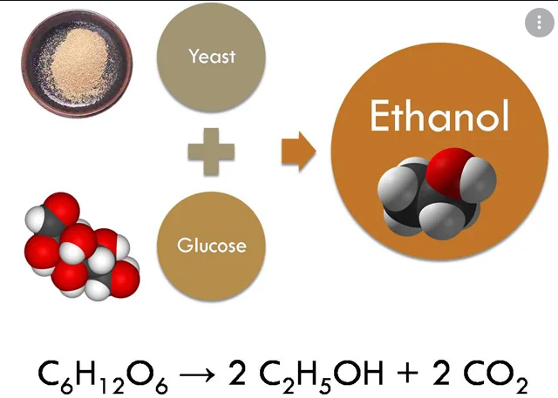
Ethanol from fermentation
Two major chemical reactions:
Hydrolysis of sucrose:
(catalysed by enzyme – Invertase)
Fermentation:
(catalysed by enzyme – zymase)

Slide 6
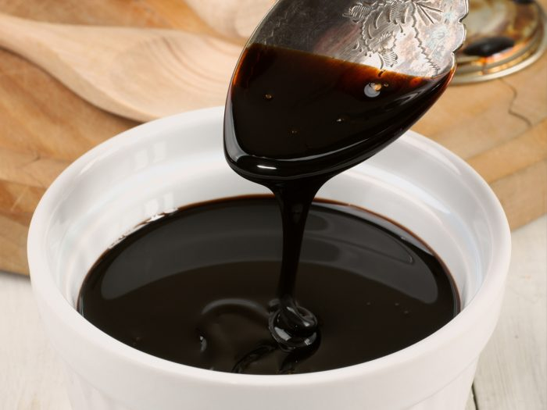
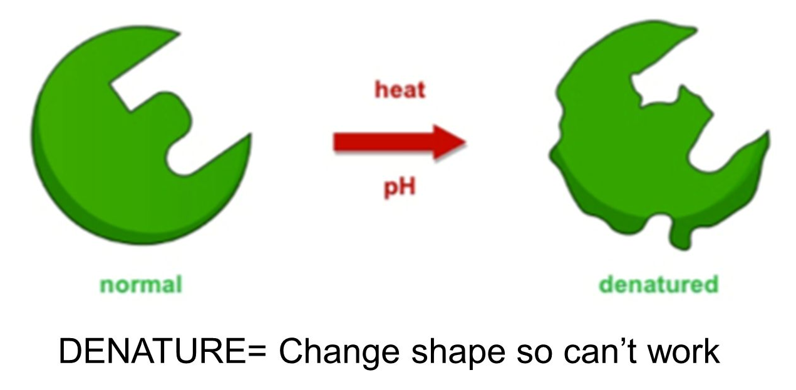
Ethanol from fermentation
Specific conditions vary depending on yeast chosen and feedstock used
1. From Molasses (waste from sugar refining)
Dilution with water 10-15% sucrose solution
Warm conditions 25-35 °C
Slightly acidic pH 3-5
Enzymes are sensitive to temperature and pH and can become denatured (structure and shape altered)
Exothermic reaction so cooling is needed, this prevents overheating and denaturing the enzymes.

Slide 7
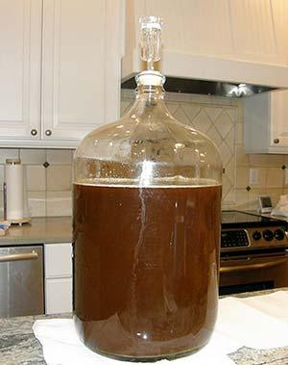
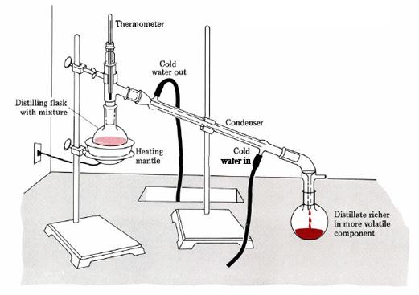
Ethanol from fermentation
In the initial phase of fermentation yeast grows and reproduces quickly, nutrients also promote growth
During this they respire aerobically and quickly deplete the oxygen
By excluding air (O₂) from the vat the mixture becomes anaerobic
The falling O₂ concentration is important as it forces conversion of glucose to ethanol rather than water and carbon dioxide
At an ethanol concentration of 8-14% fermentation ceases as yeast becomes poisoned,
Yeast is separated (filtration) and then the alcohol by distillation
which raises the alcohol concentration to 95%

Slide 8
Ethanol from fermentation
2. From starch (corn and wheat)
Uses similar process but different enzymes and reaction conditions
Starch is mixed with water and pH adjusted to around 6
Heating the mixture to around 90°C in the presence of alpha amalyse enzyme breaks down the starch to simpler sugars
Mixture is then cooled to 33°C
Glucoamylase enzyme and yeast further breaks down sugars to glucose which are then fermented
Ethanol retrieved by distillation and solids are used to produce stockfeed

Slide 9
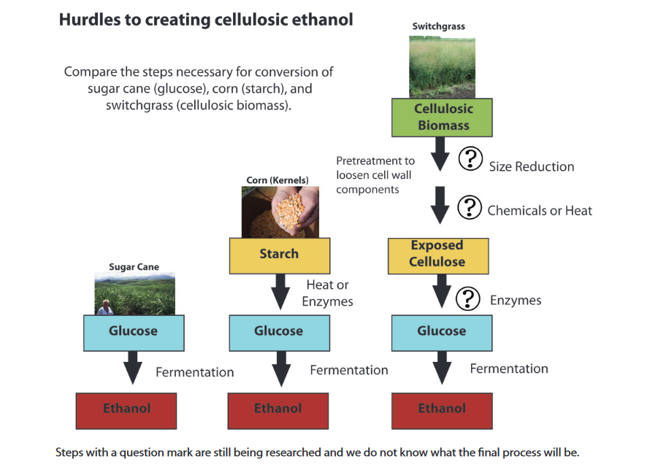
Ethanol from fermentation
3. From woody biomass?
Eliminating the need to use a food based crop to produce ethanol?

Slide 10
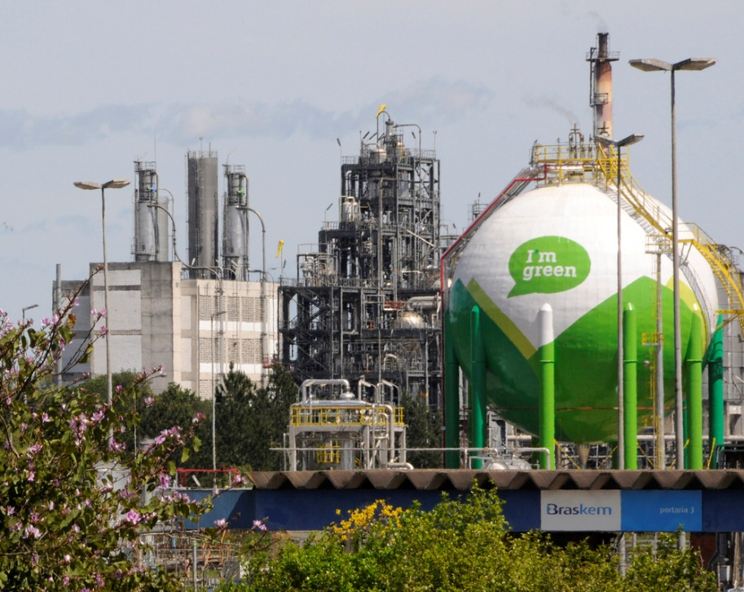
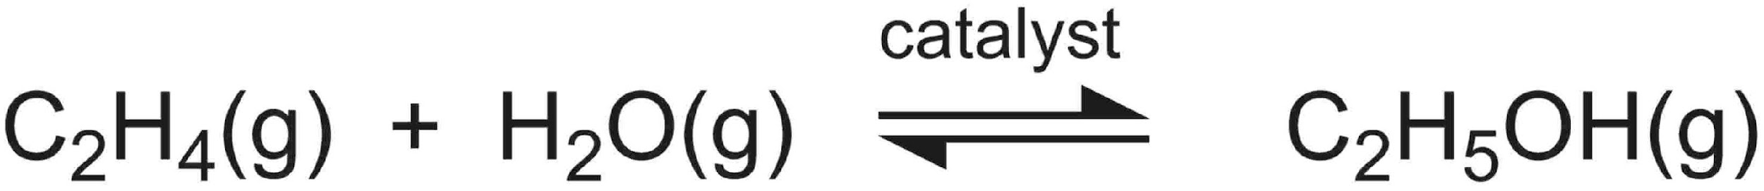
Ethanol from ethene
Quicker method (time), although uses ethene from fossil fuels
Uses acid catalysed addition of water to ethene
Mixture of steam and ethene through a catalyst bed made of silica particles coated with pure phosphoric acid

Slide 11
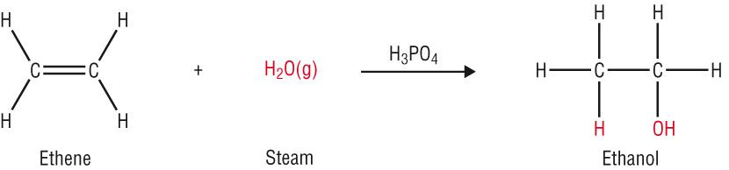
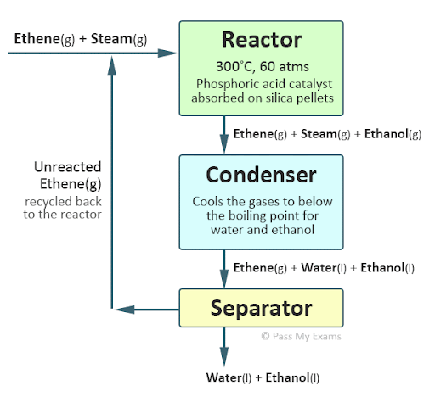
Ethanol from ethene
Temperature of around 300°C and a pressure of 6000-7000 kPa is used
Exothermic nature of reaction means products are favoured by low temperature
Chosen temp is compromise between maximising rate (high temp) and maximising yield (low temp)
High pressure favours both high yield and fast rate
Catalyst increases rate but no effect on yield

Slide 12
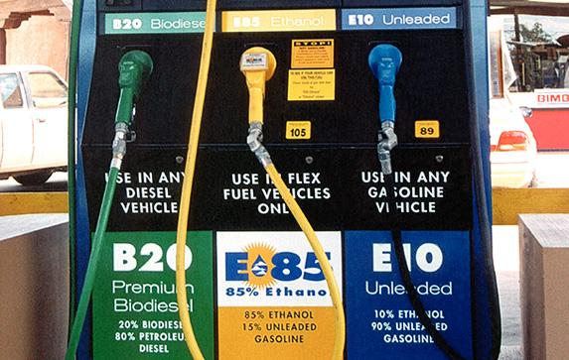
Ethanol from ethene
Steam is present as a limiting reagent at a 1 : 0.6 ratio as higher concentrations of steam results in dilution and washing away the phosphoric acid catalyst
With these conditions, a conversion of 5% occurs as the reagent quickly pass through the catalyst bed
By separating and continually recycling the unreacted reactants an overall yield of 95% is achieved ethanol produced this way does not have the advantages as other biofuels as non-renewable petroleum based resources are used

Slide 13
Comparison
Ethanol: Synthesis by fermentation | Ethanol: Synthesis from ethene
Uses renewable feed stocks | Uses non-renewable fossil fuels
Uses enzymes to minimise energy | Uses catalysts to optimise rates and allow a temperature compromise (exothermic reaction)
Safe process no high temps or pressures | Requires more cost for high temperatures and pressures
Can be a long process | Reactants feed through in stoichiometric ratios
Heat recovered for other uses | Ethanol product constantly removed to drive equilibrium
Lower atom economy (51%) | Can be a continuous process
Waste products can be used as feed stock | Maximum atom economy (100%)
Close to carbon neutral | Not carbon neutral

Slide 14
On going work
Essential chemistry, Set 21 Q 1 -9
Work on your extended response assessment

